Slide 1
Ransomware in Cybersecurity
presented
by
kartik v
3 rd year CSE
salem college of engineering and techonology

Slide 2


problem statement
*Problem Statement:*
Ransomware poses a signiﬁcant threat to individuals, businesses, and organizations worldwide. It encrypts critical data, rendering it inaccessible until a ransom is paid. This can lead to ﬁnancial losses, data breaches, and operational disruptions.

Slide 3


_Pr_oposed S_ystem/Solution
The proposed system aims to enhance cybersecurity measures to mitigate the risks associated with ransomware attacks. This includes implementing robust security protocols, educating users about potential threats, and developing effective incident response strategies.

Slide 4
_S_ystem Development Approa_ch (_Technology Used)
The system development approach involves utilizing a combination of technologies such as advanced encryption algorithms, intrusion detection systems, machine learning for anomaly detection, and secure backup solutions. Additionally, user training and awareness programs are integral components of the approach.

Slide 5


Al_go_r_i_t_hm & Deploy_me_nt_
Various algorithms are employed in the system, including encryption algorithms like AES (Advanced Encryption Standard) for data protection and machine learning algorithms for
detecting ransomware behavior patterns.
The
system is
deployed across different platforms, including cloud-based solutions for scalability and ﬂexibility.

Slide 6
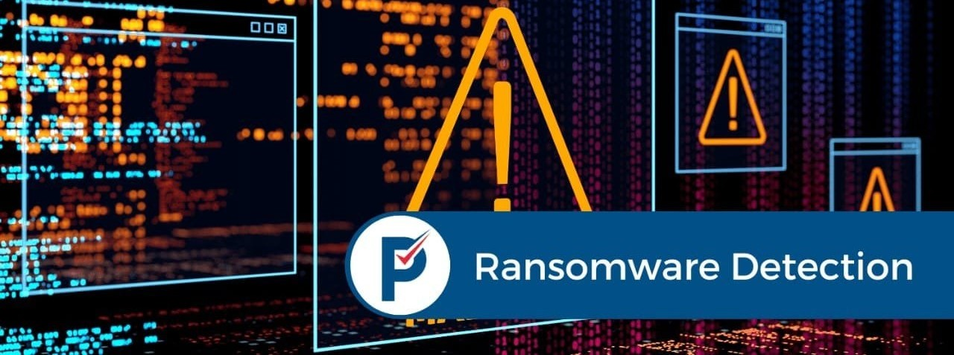
_Result_(Output Image)

Slide 7

Conclusion
Ransomware remains a signiﬁcant cybersecurity threat, but by adopting proactive measures and leveraging advanced technologies, organizations can enhance their defenses against such attacks. It is crucial to stay vigilant, continuously update security measures, and collaborate with cybersecurity experts to mitigate the risks posed by ransomware.

Slide 8
_F_uture Scope
The future scope of the system includes further research into AI-driven ransomware detection techniques, development of more resilient encryption methods, and international collaboration to combat ransomware on a global scale. Additionally, there is a need for ongoing education and awareness campaigns to empower users in recognizing and preventing ransomware attacks.

Slide 9
_Referenc_es
Smith, J., & Jones, A. (Year). "Ransomware: Evolution and Impact." Journal of Cybersecurity, 10(2), 123-145.This paper provides insights into the evolution of ransomware and its impact on various industries, offering valuable context for understanding the current threat landscape.

Slide 10

Thanks!
presented
by
kartik v 3rd year CSE
salem college of engineering and technology

